Slide 1
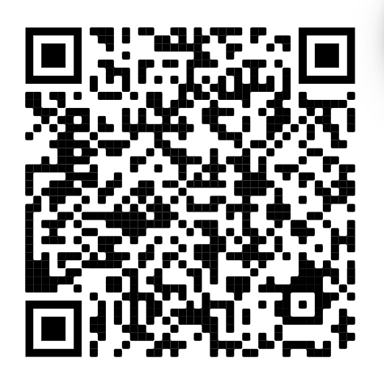

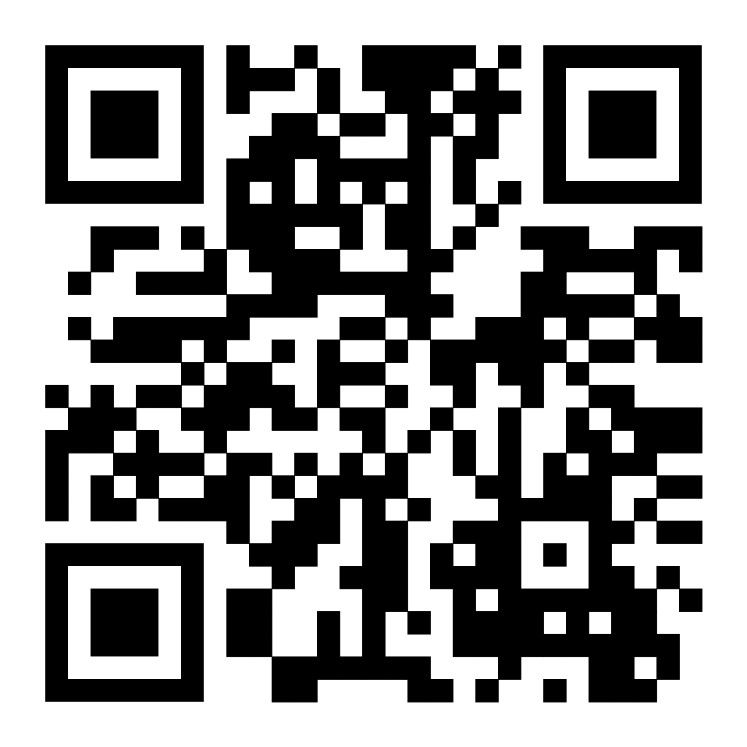
LinkedIn for Beginners
Sign in here →
Brought to you by Pitt WiCS
← Sign up for mentorship program here

Slide 2
LinkedIn
What
Social media platform used for professional networking
Why
Connect with others
Showcase your skills
Visibility & branding
How
Create a profile
Input your education, experiences, anything!
Connect with people
Post stuff
(optional!)

Slide 3
What are we gonna work on?
Header
Skills
Intro + About
Technical + Non-technical
Background
Accomplishments
Education + Experience + Volunteering
Courses + Projects + Awards + Languages + Organizations

Slide 4
Anitas really cool linkedin
(18) Anita Kaul | LinkedIn

Slide 5

How’s this post?
Although I didn’t really deserve the job for Software Development Intern at Facebook, I had a great experience nonetheless! Thank you to all my mentors, supervisors, and managers who helped me get this opportunity!

Slide 6
Pls dont do that like that post actually sucks ass
Do not sell yourself short. You got the job because you deserve it!!! Do not let anyone let you think otherwise

Slide 7
How about this?
I had an amazing time working at Apple this summer! They taught me so much Full Stack Development. I got to work with tons of SQL Databases and developed several public-facing features to their websites! With a little more practice, I might finally put it on my resume!

Slide 8
Wrong again. Do not say that lol
Do not fall under the illusion that you need to know a program inside and out before putting it on your resume. Even if you barely have any knowledge of it, it is still knowledge. Very often, women refrain from putting experiences on their resume because they feel they are not educated enough. DO NOT DO THAT. put that shit in if you even touched it.

Slide 9
Next one
Had an amazing time this past summer at Google. They taught me some awesome stuff, and I can’t wait to see what the future holds.
Here are some highlights from my experience:
Made a game
Deployed production code
Thank you to my amazing manager Jennifer for your endless support!

Slide 10
Getting there, but this is not specific in the slightest
When you are describing your experiences, make sure to mention what programs you used (ie MySQL, Github, Javascript, etc)
In addition, give what problem you solved and what you learned from the process

Slide 11
Last one:
Had a fantastic experience at BNY Mellon as a Software Developer Intern. During my time here, I created multiple business solutions that improved the contractor approval process using Javascript, HTML, and CSS. In addition, I presented to a board of executives potential adoptive technologies that would improve workplace efficiency.
I would like to thank my manager Kyle, my mentor Katherine, and my fellow interns for their continuous guidance throughout this past summer. Onto the next!

Slide 12
This is a slay. That slays like a lot
-Where you worked and your position
-What you did SPECIFICALLY
-What you learned and how you implemented a solution
-Thank your people
-End on optimistic note

Slide 13
For the remainder:
Groups:
-Whoever needs to CREATE an account
-Whoever needs to IMPROVE an existing account and would like feedback
At any time, write your LinkedIn on a sticky note and start making connections!

